Slide 1

Making Apps More Human
AN INTRO TO MICROSOFT’S COGNITIVE SERVICES
Matthew Soucoup
PRINCIPAL
@codemillmatt codemilltech.com
Headshot optional

Slide 2


Slide 3


Slide 4

Unfamiliar places…

Slide 5

Different languages…

Slide 6
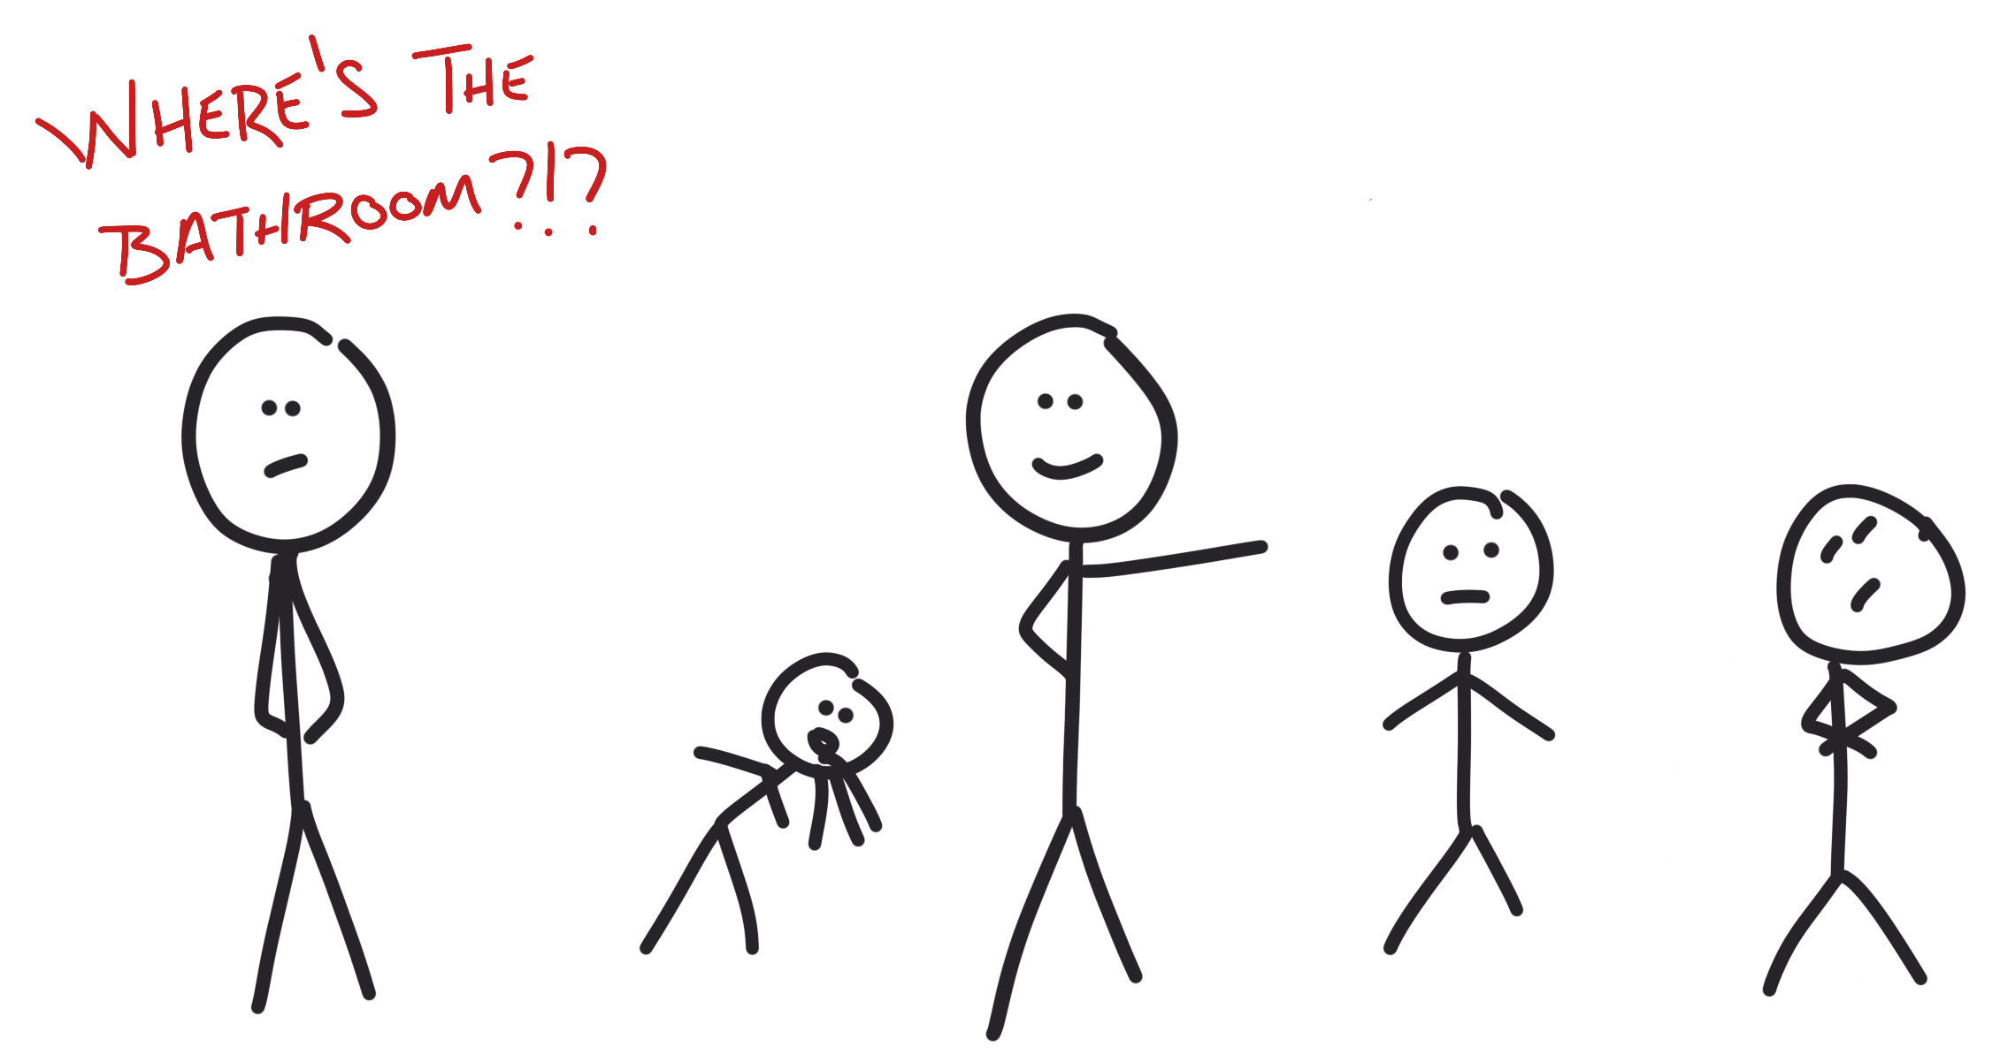
Who to ask questions to…

Slide 7

An app … that can be human?

Slide 8

Microsoft Cognitive Services

Slide 9
Cognitive Services - REST APIs
Hosted in Azure
Machine Learning
Vision
Speech
Language
Knowledge
Search

Slide 10







Vision
Content Moderator
Emotion
Video Indexer
Video API
Computer Vision
Face API
Custom Vision Service
Notes:
Computer vision
Content moderator
Video API
Video Indexer
Face API
Emotion API
Custom Vision Service

Slide 11




Speech
Bing Speech API
Custom Speech Service
Speaker Recognition
Translator API
Notes:
Translator
Bing
Recognition
Custom service

Slide 12






Language
Language Understanding
Web Language Model
Translator API
Text Analytics API
Bing Spell Check
Linguistics Analysis
Notes:
LUIS
Spell check
Language model
Text analytics
Translator
Lingustics analysis

Slide 13






Knowledge
QnA
Explorations
Recommendations API
Academic Knowledge API
Entity Linking
Custom Decision
Notes:
Recommendations
Explorations
Entity Linking
Academic
QnA
Custom decision

Slide 14







Search
Bing News API
Entity
Search API
Bing Autosuggest API
Video API
Custom Search API
Image API
Notes:
Autosuggest
News
Web
Entity
Image
Video
Custom

Slide 15

The Vacation Itinerary…

Slide 16
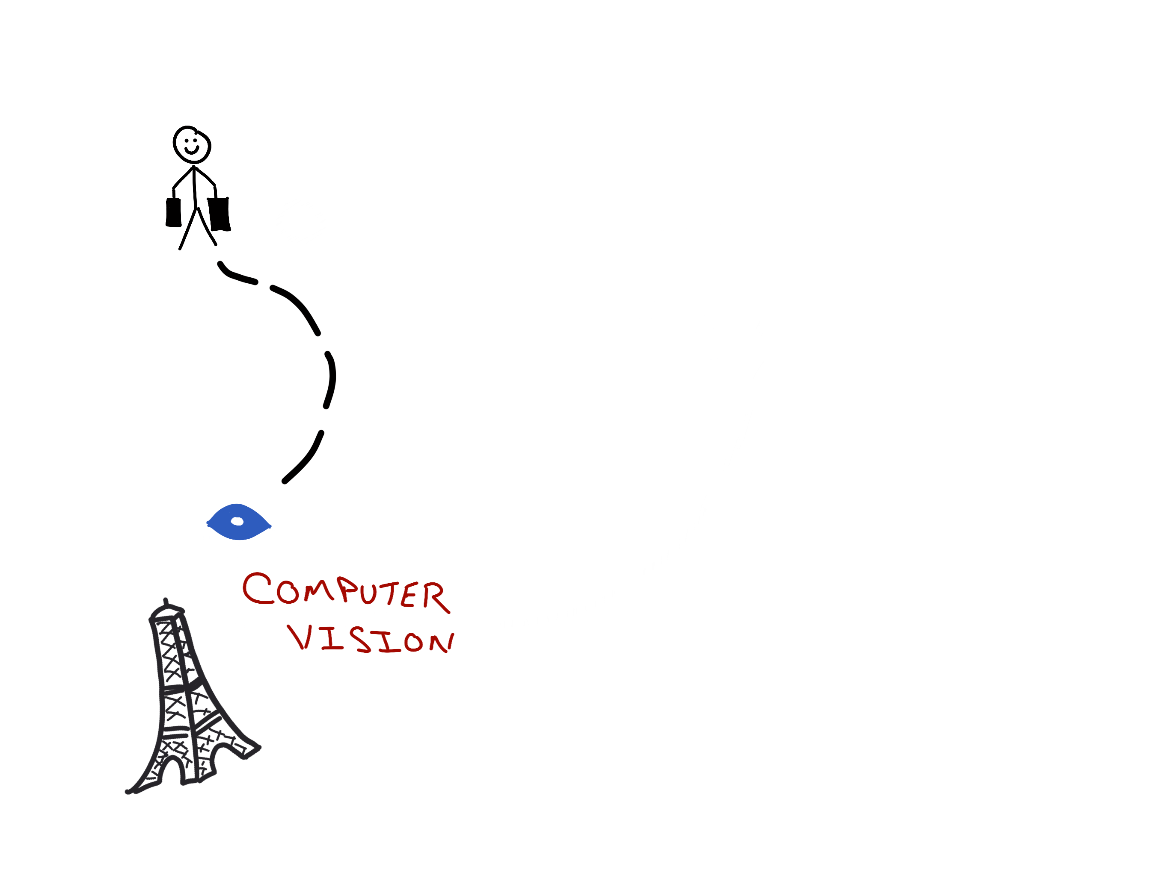
The Vacation Itinerary…

Slide 17
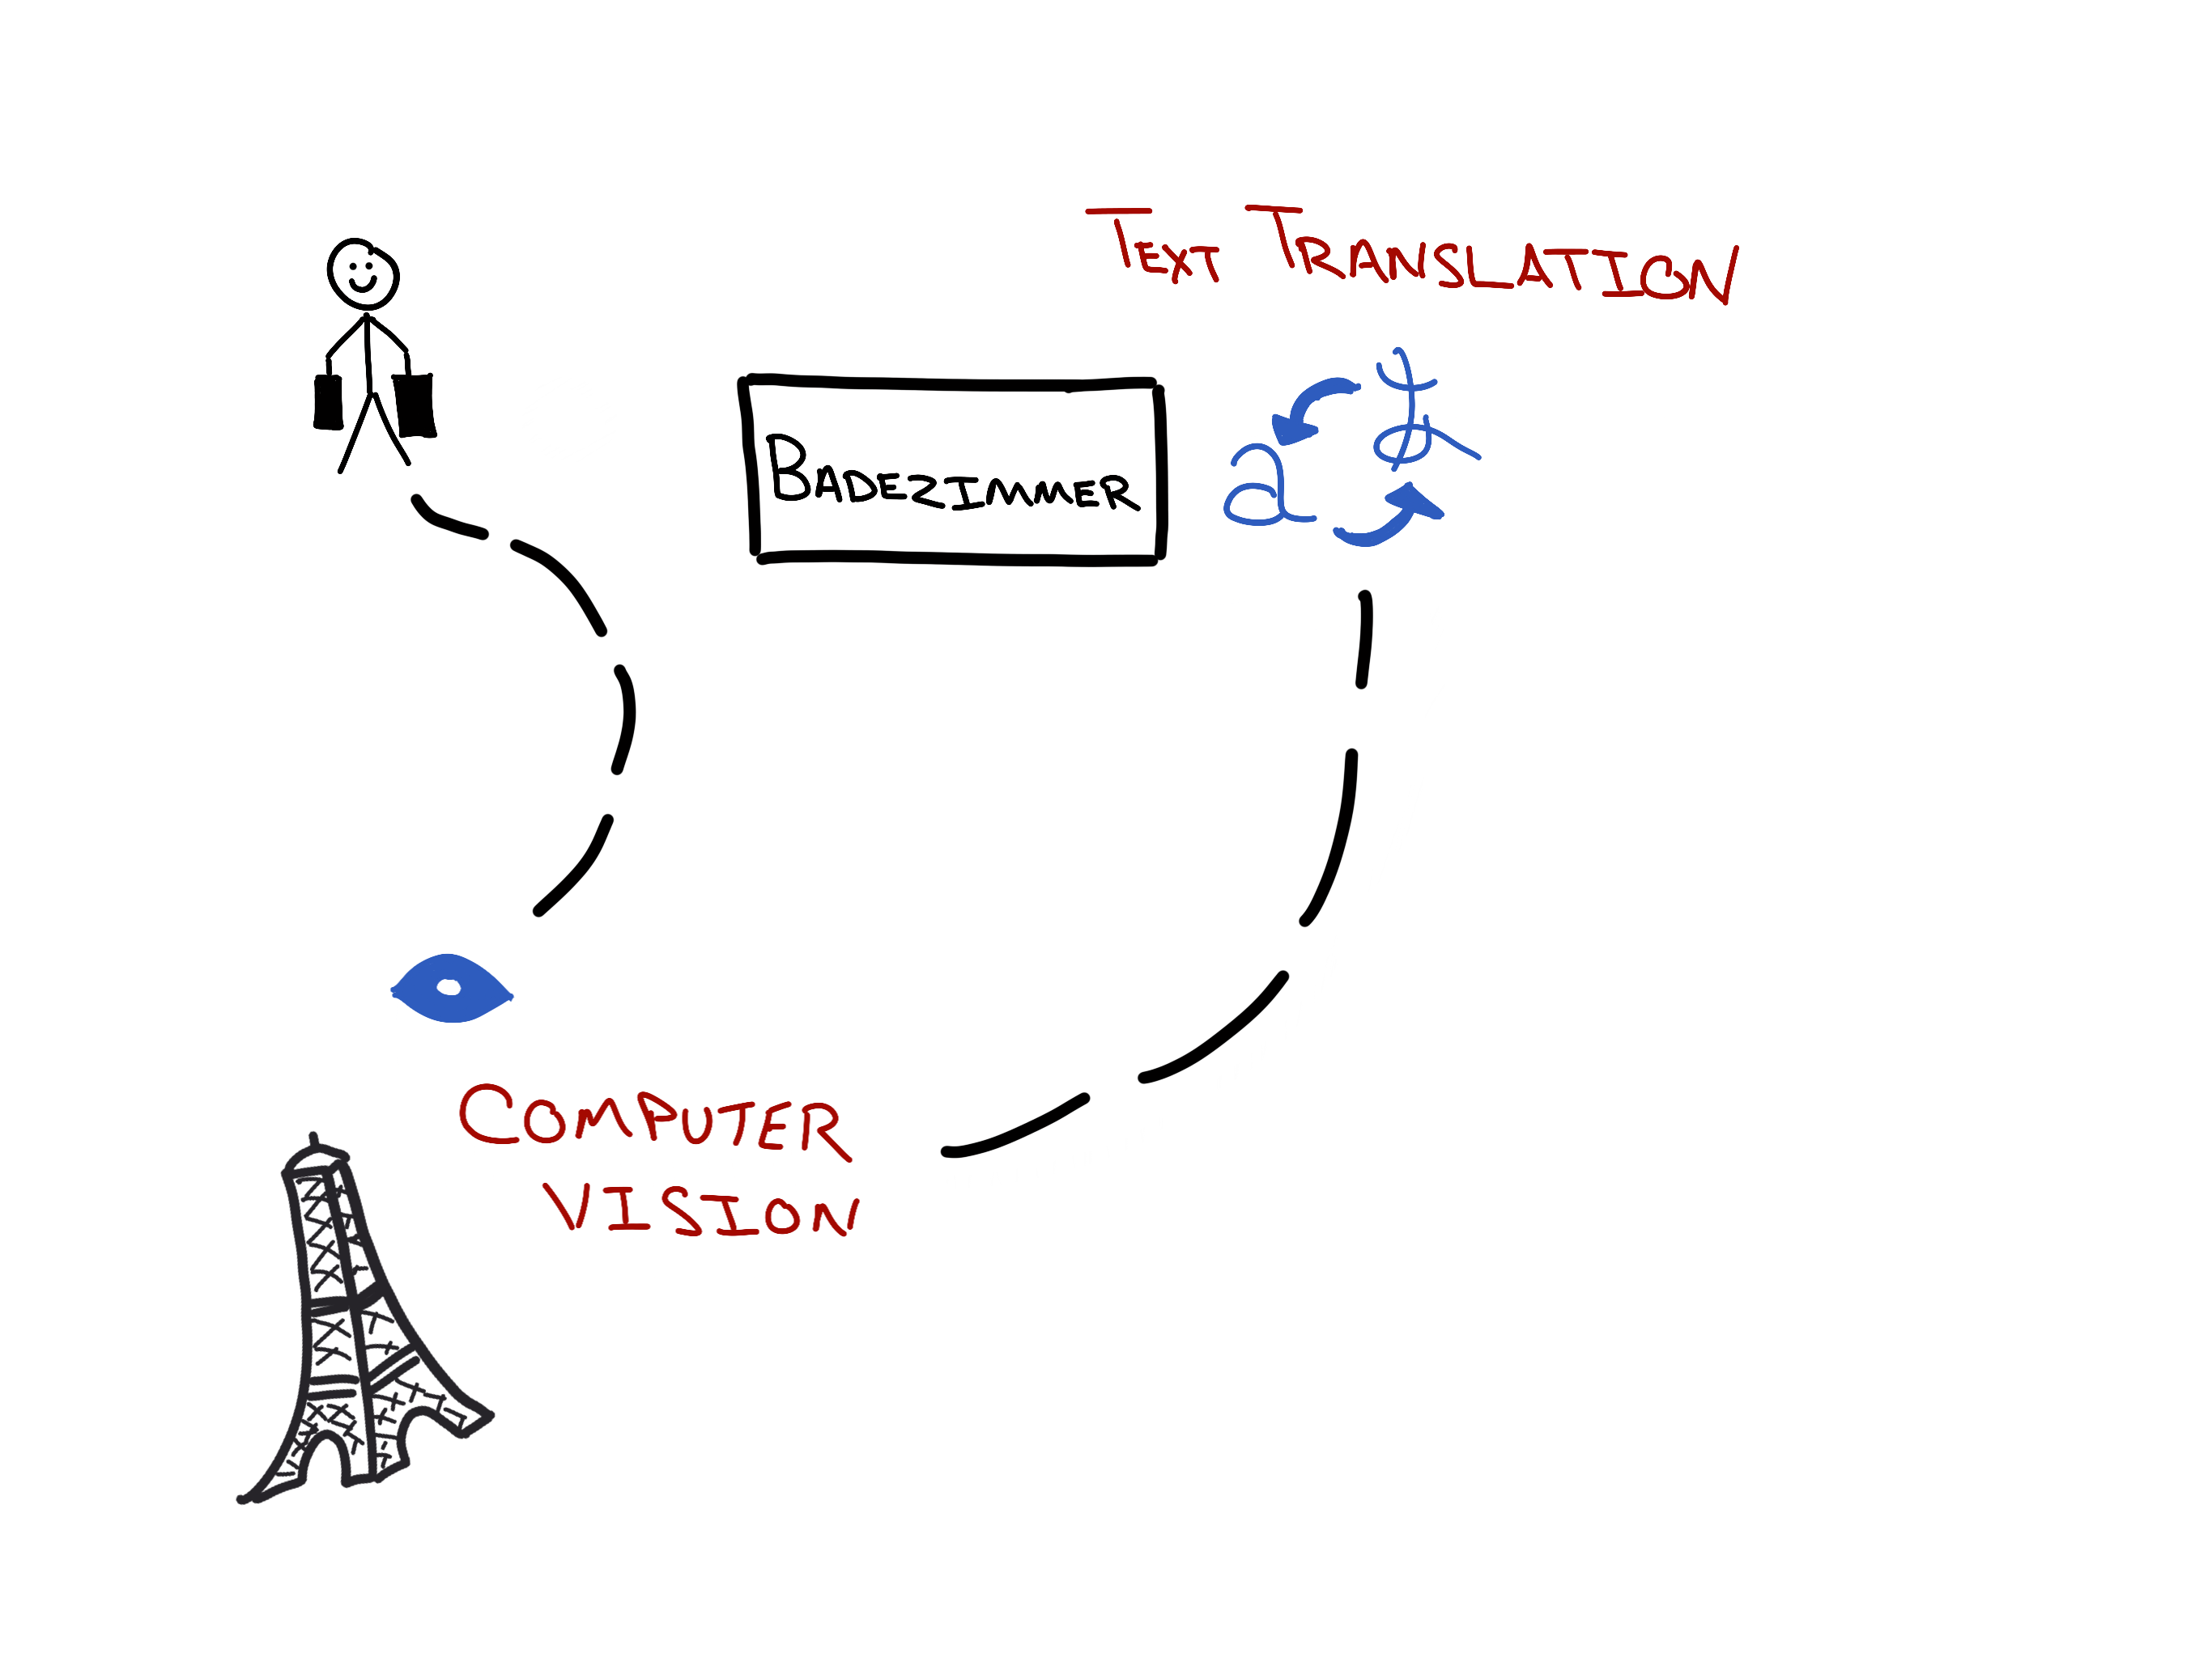
The Vacation Itinerary…

Slide 18
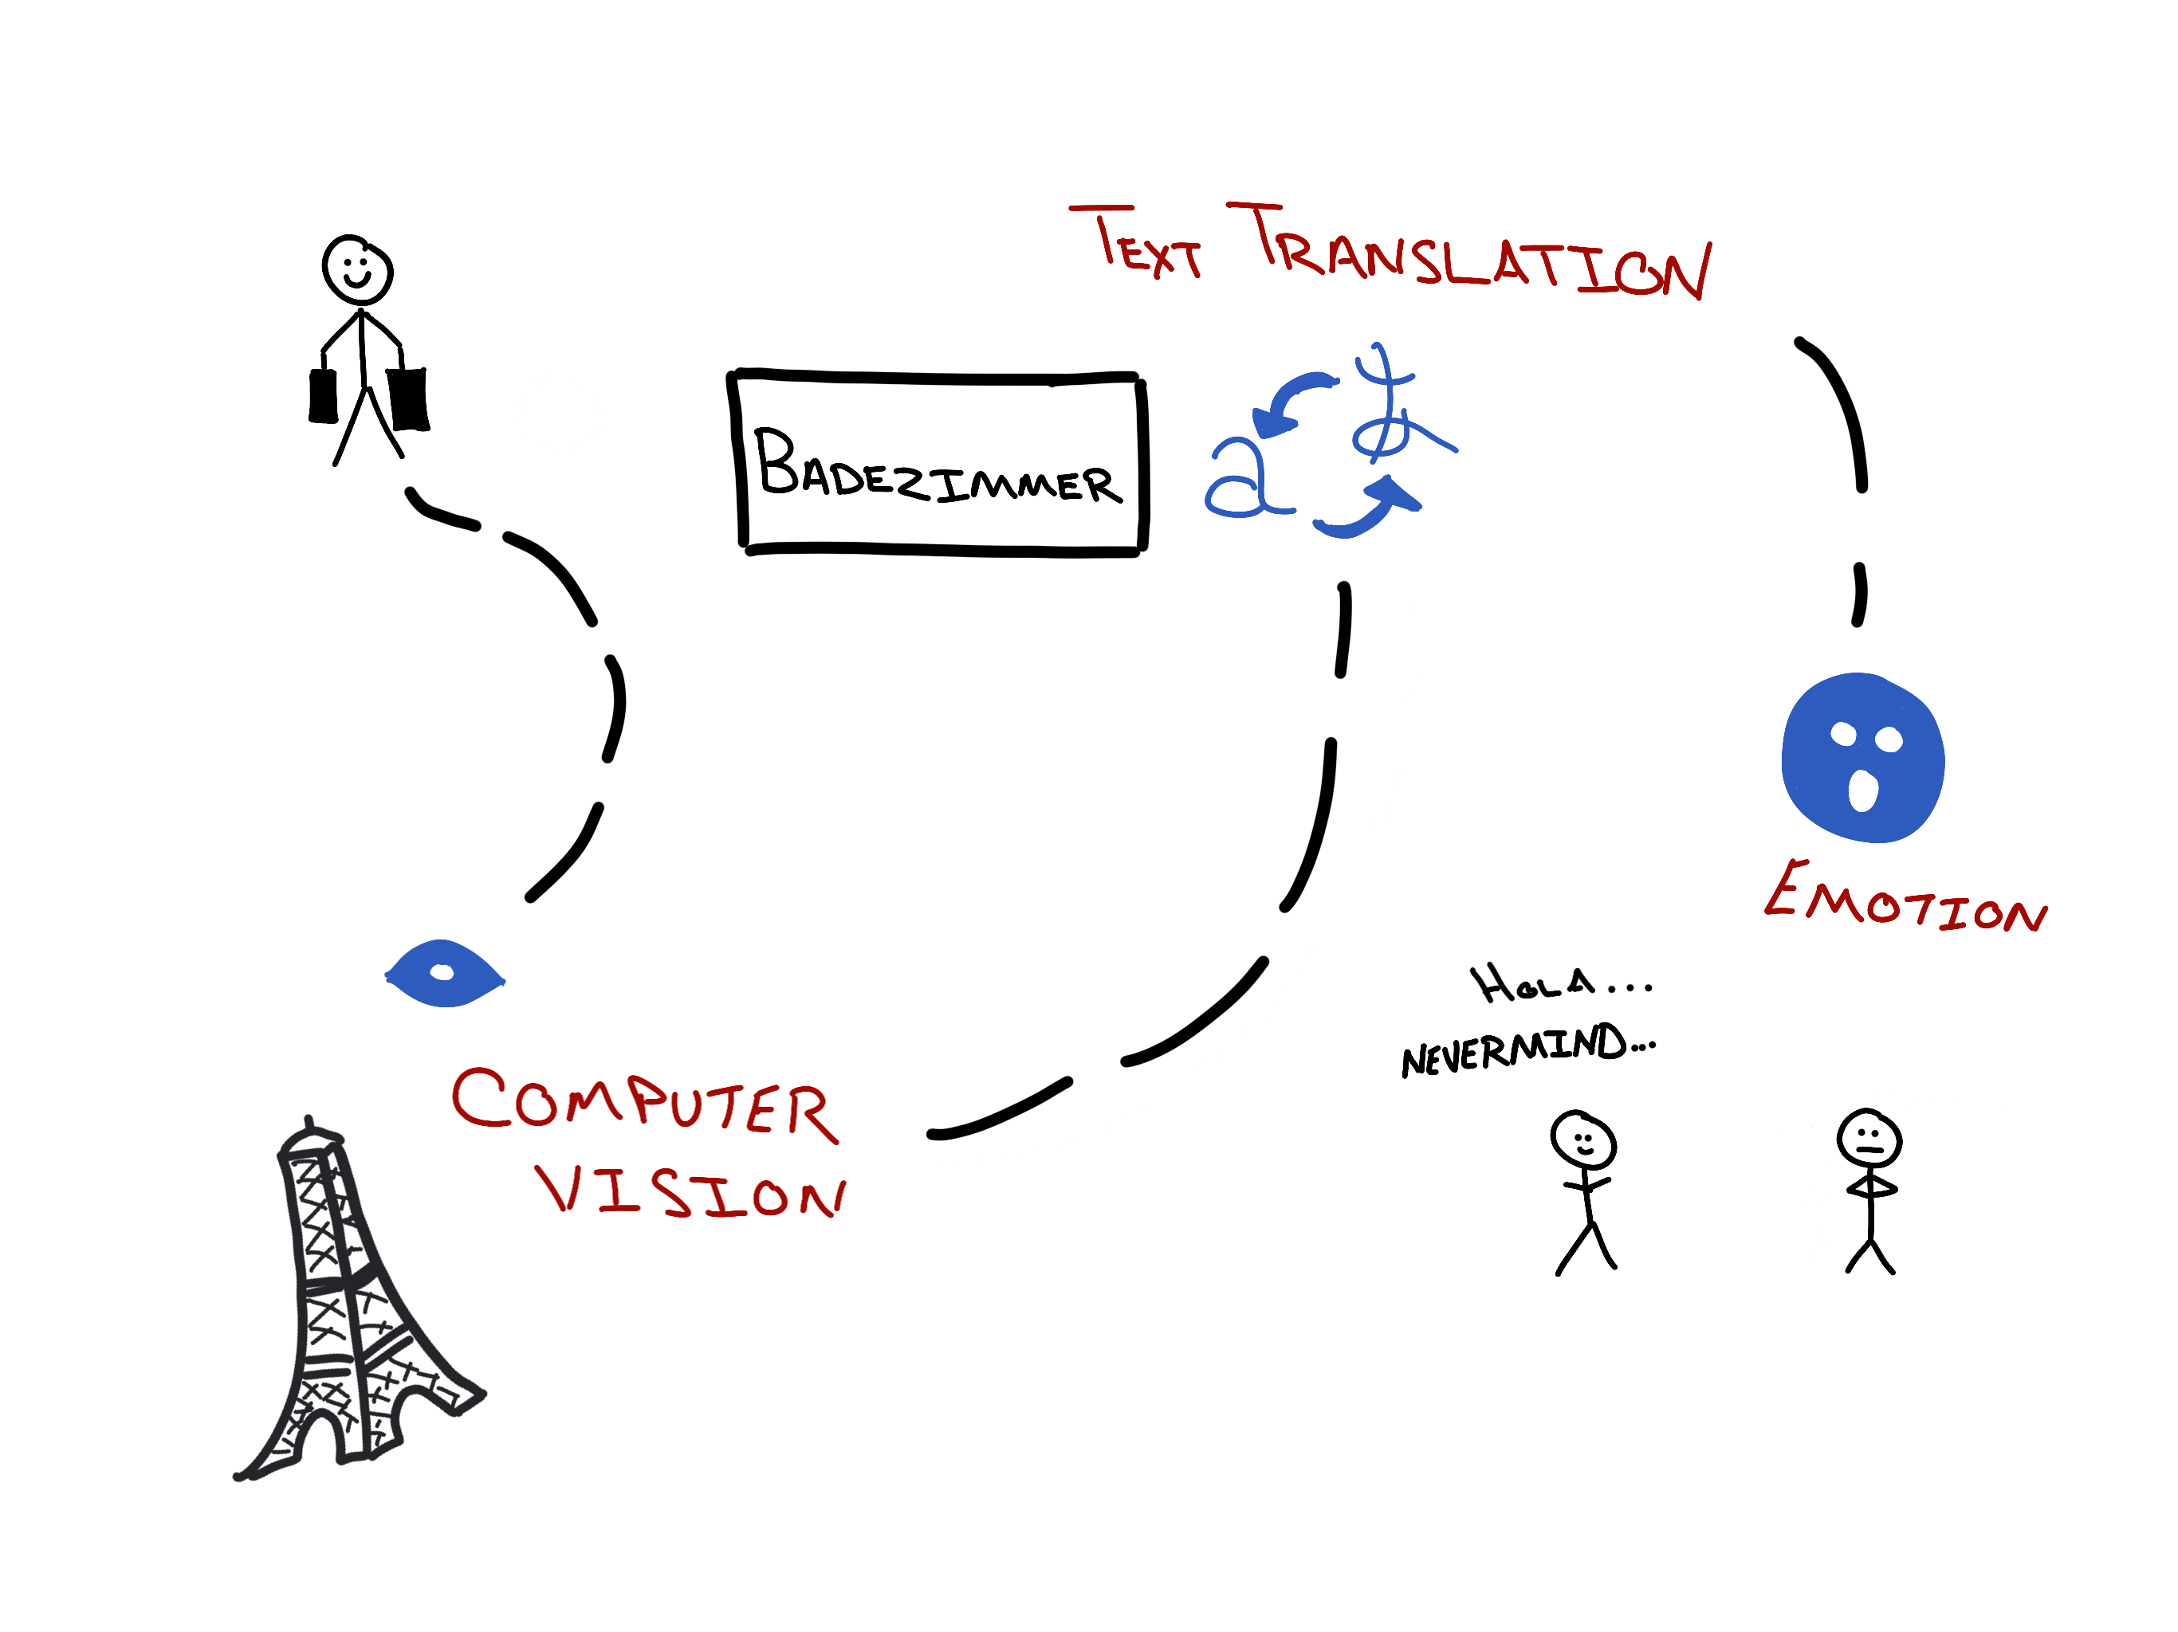
The Vacation Itinerary…

Slide 19

Computer Vision API
What’s in a photo??

Slide 20
Inspection Endpoints
Analyze
Recognize
Celebrities
Landmarks
Describe
Tag

Slide 21
Analyze - POST
https://api.cognitive.microsoft.com/vision/v1.0/
analyze
[?visualFeatures]
[&details]
Visual Features
Details
Body
Categories
Tags
Description
Faces
ImageType
Color
Adult
Celebrity
Landmark
URL to image
Binary of image

Slide 22
Analyze – return values
Description
Tags
Category array
Tags array
Faces array
Adult score
Color
Metadata
ImageType

Slide 23
Description…
Full sentences
Person laying on the beach
Notes:
Mention it will include percentages

Slide 24
Categories array…
86 predefined
Outdoor->Ocean/Beach
Outdoor->Water
Scene->Sky->Sun
Object->Plant->Tree
People

Slide 25
Tags array…
Sunny
Outside
Tree
Person
Water
Notes:
Mention it will include percentages

Slide 26
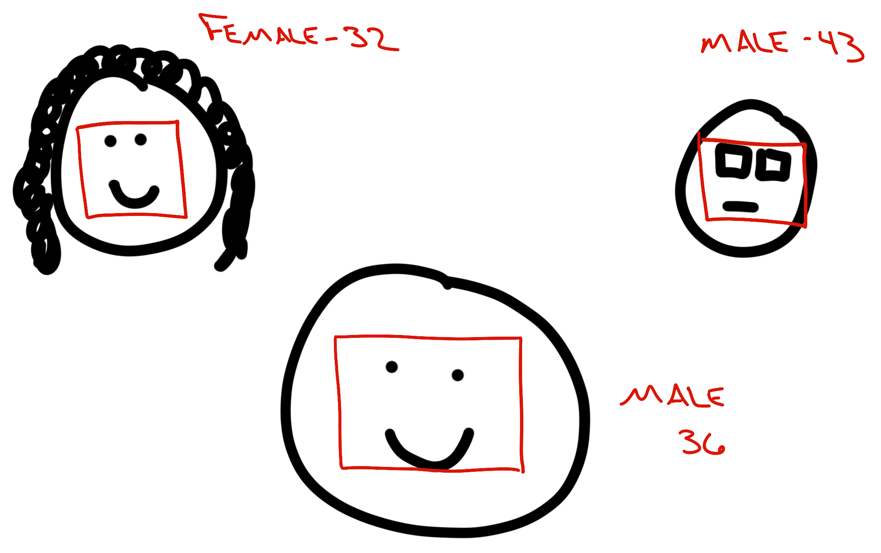
Faces array…
Up to 64 faces
Gender
Age
Coordinates in image

Slide 27
Describe & Tag - POST
https://api.cognitive.microsoft.com/vision/v1.0/describe[?maxCandidates]
https://api.cognitive.microsoft.com/vision/v1.0/tag
Body
URL to image
Binary of image

Slide 28

OCR endpoint
Recognize text in images
Including handwritten
Corrects rotation
Reads blocks
Separately
Notes:
Mention it will include percentages

Slide 29


Slide 30
The Vacation Itinerary…

Slide 31

Translator API
The multilingual machine…

Slide 32
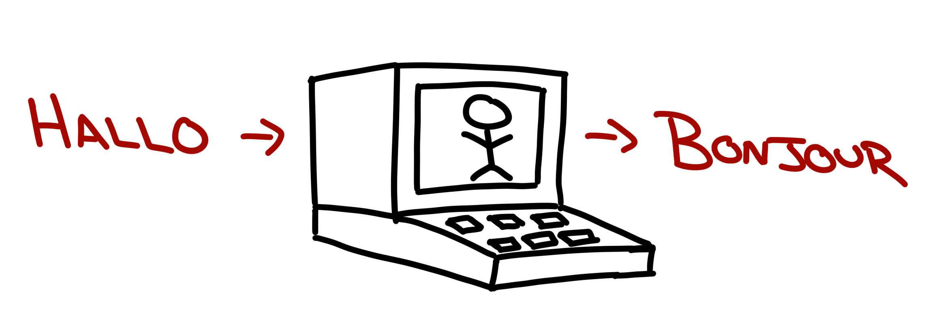
Translate text…

Slide 33
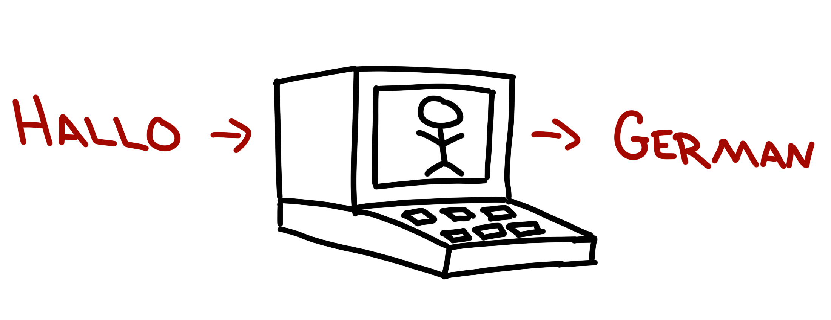
Detect language…

Slide 34

Speak!!!

Slide 36
The Vacation Itinerary…

Slide 37

Emotion API
The feeling cloud…

Slide 38

Score emotions in photos

Slide 39
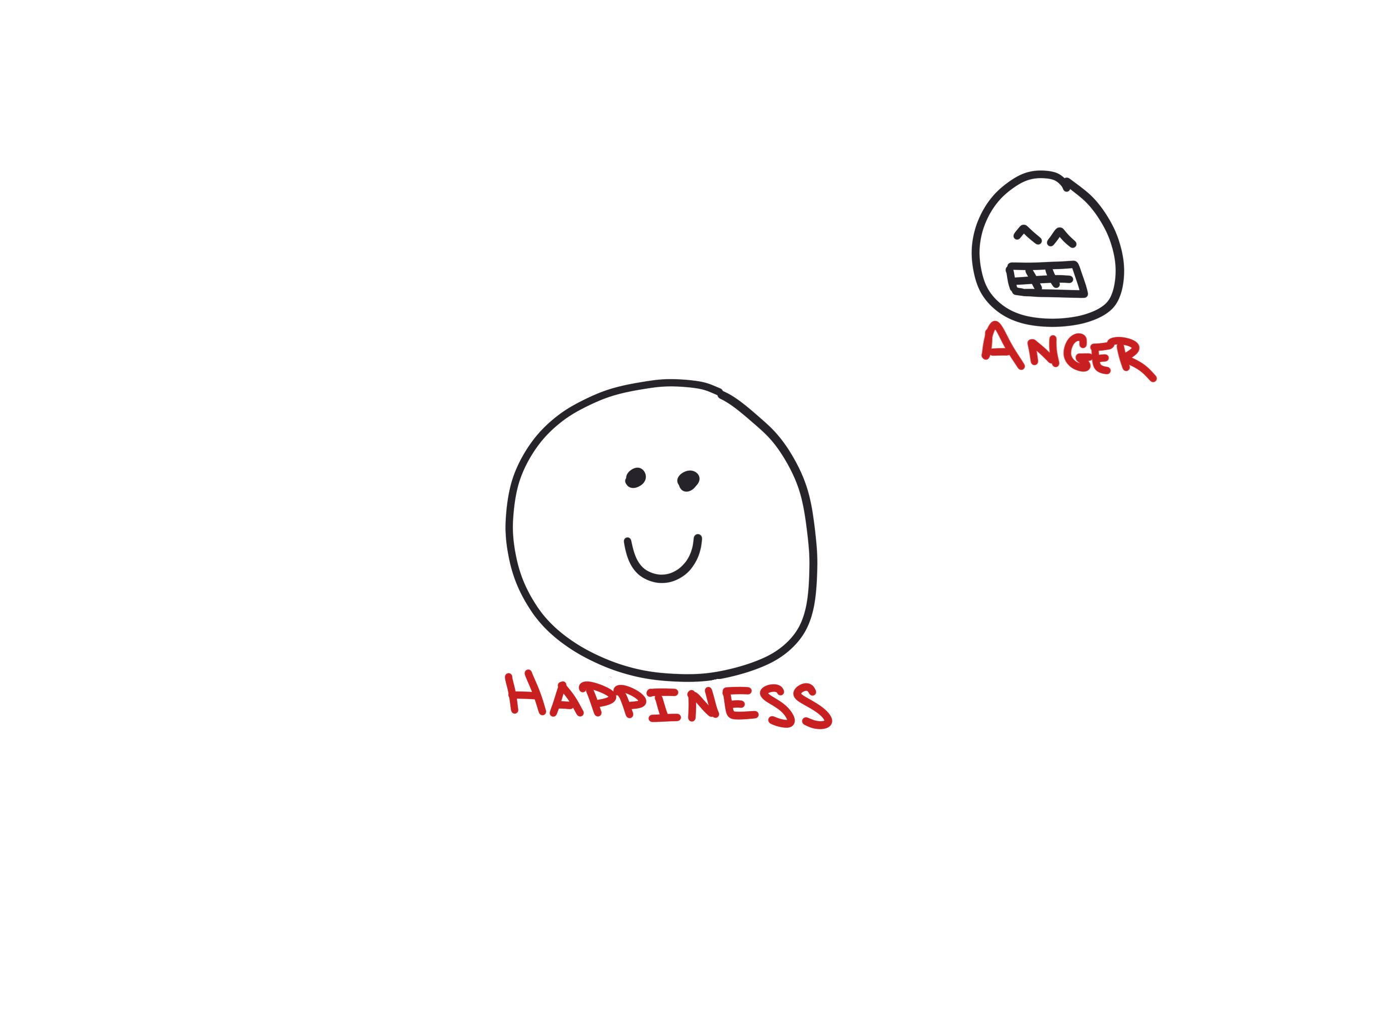
Score emotions in photos

Slide 40
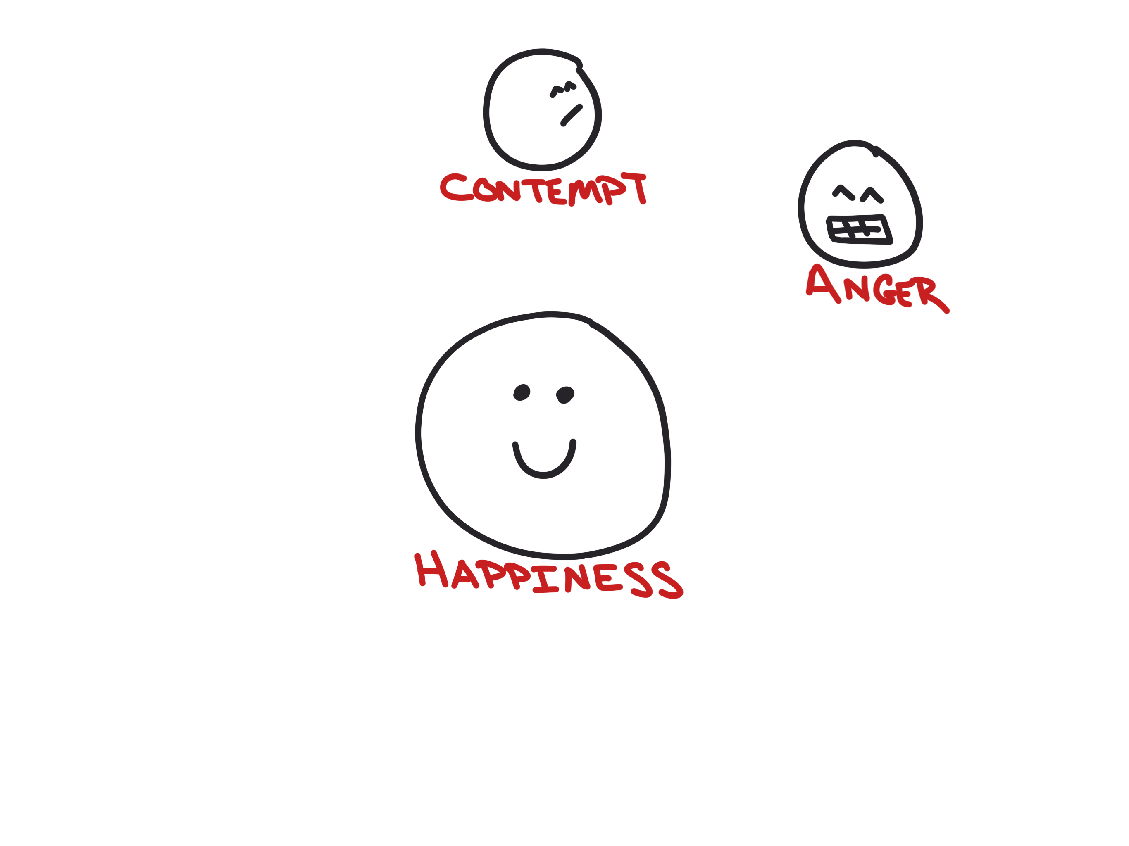
Score emotions in photos

Slide 41
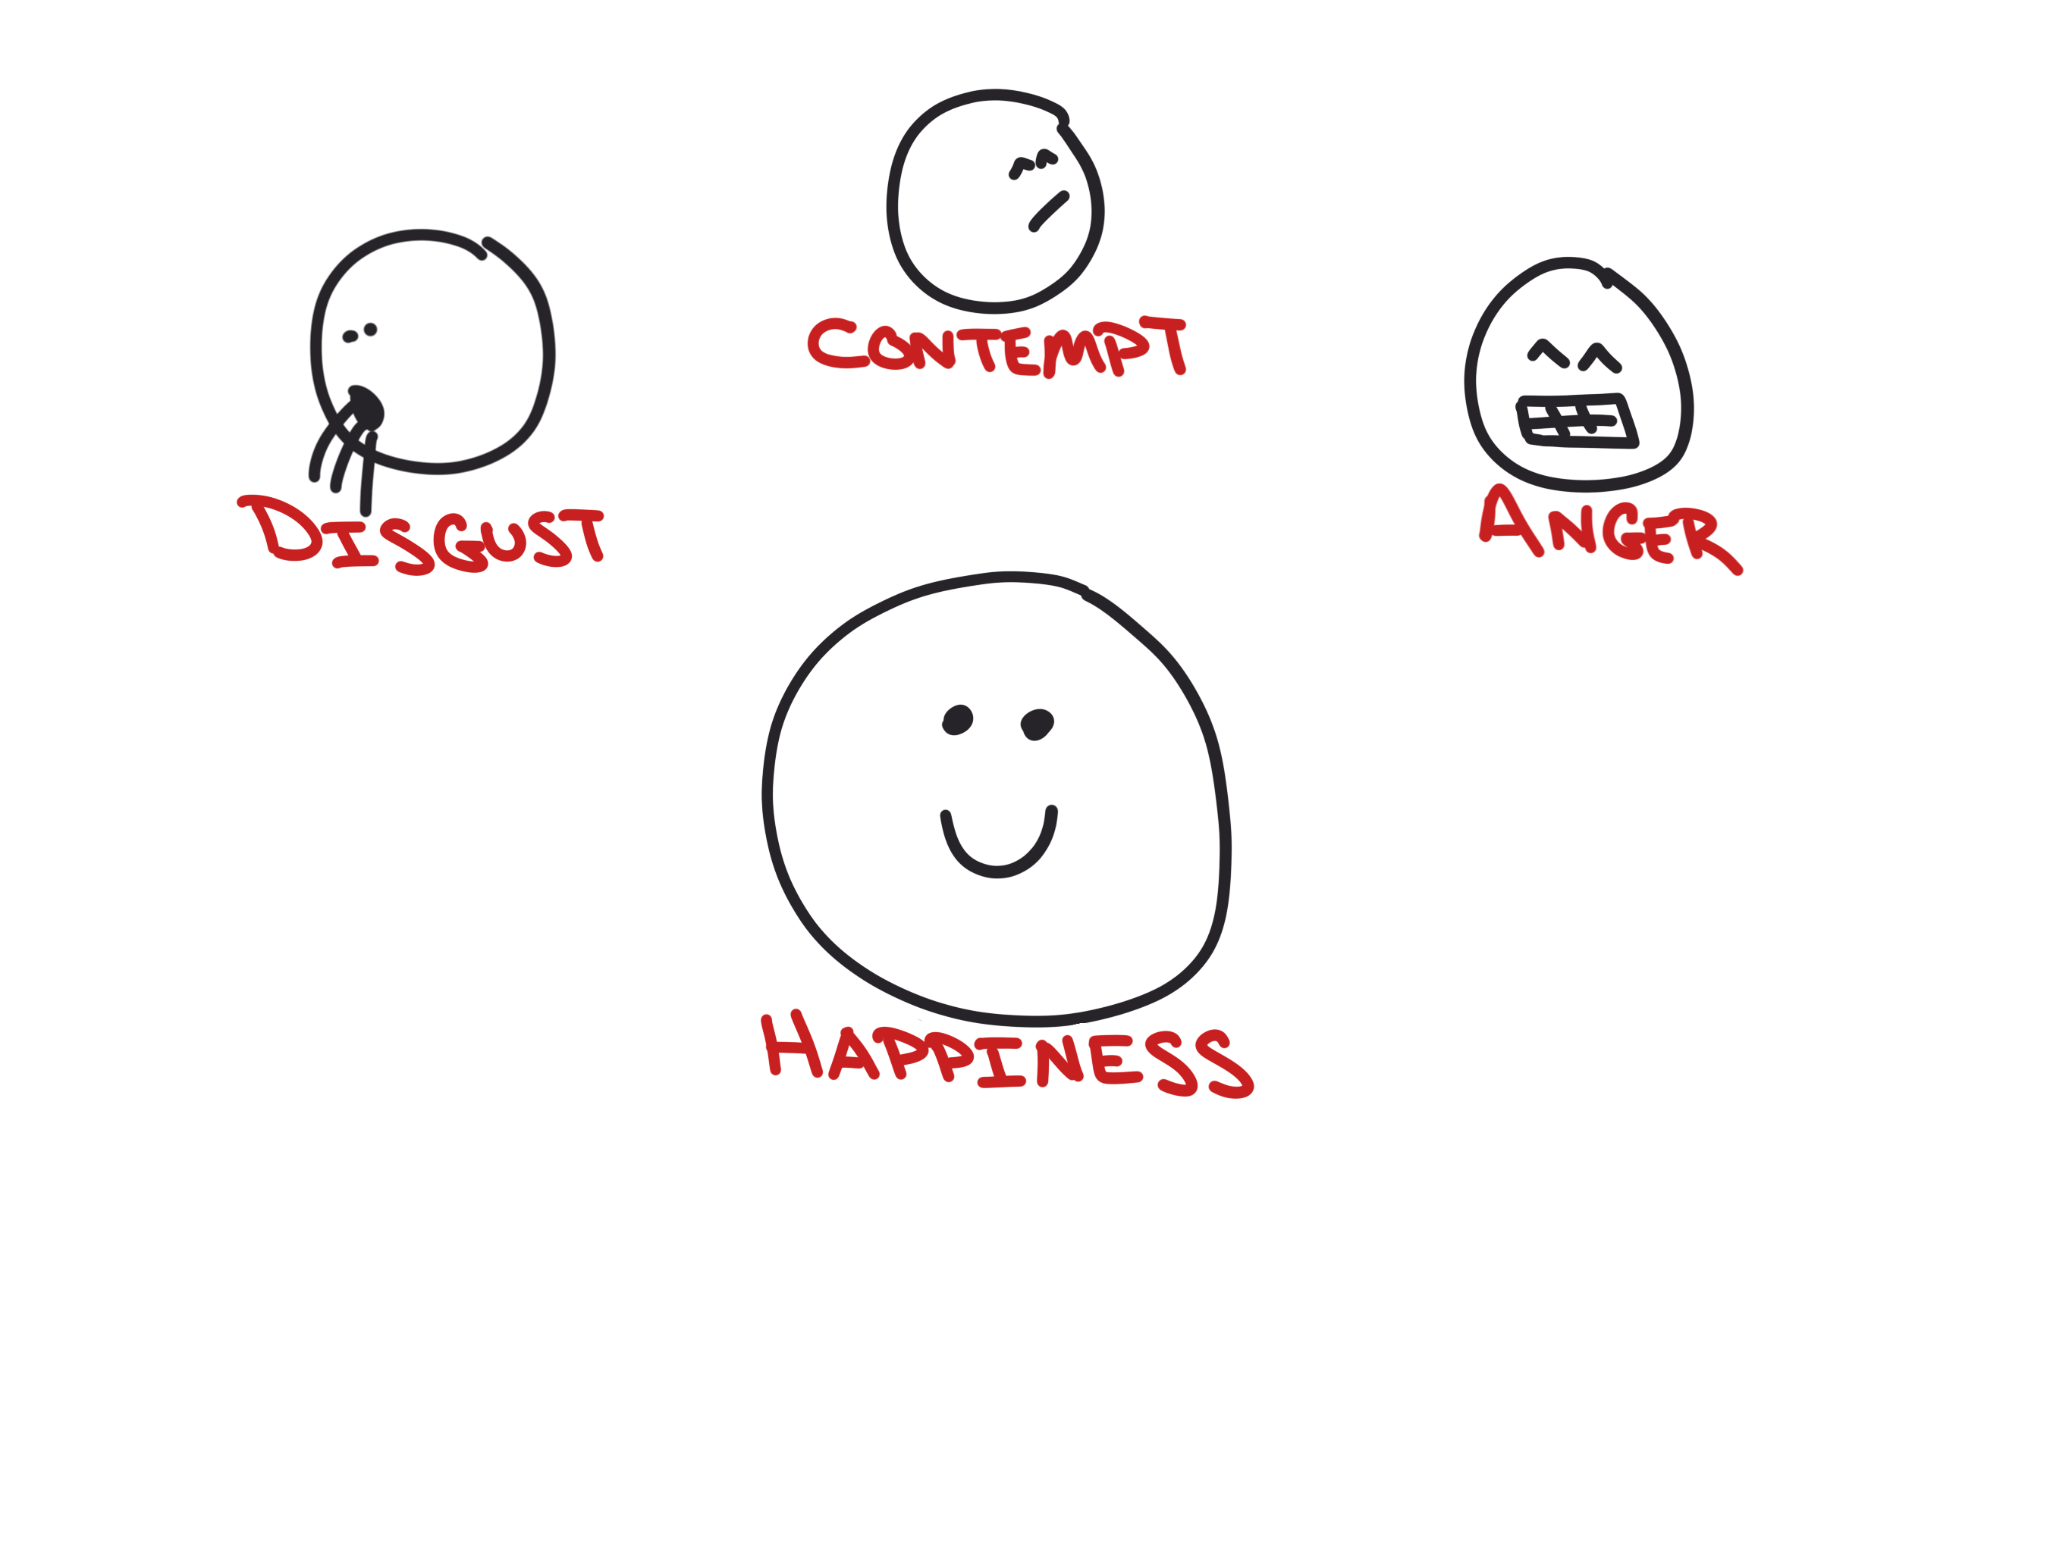
Score emotions in photos

Slide 42
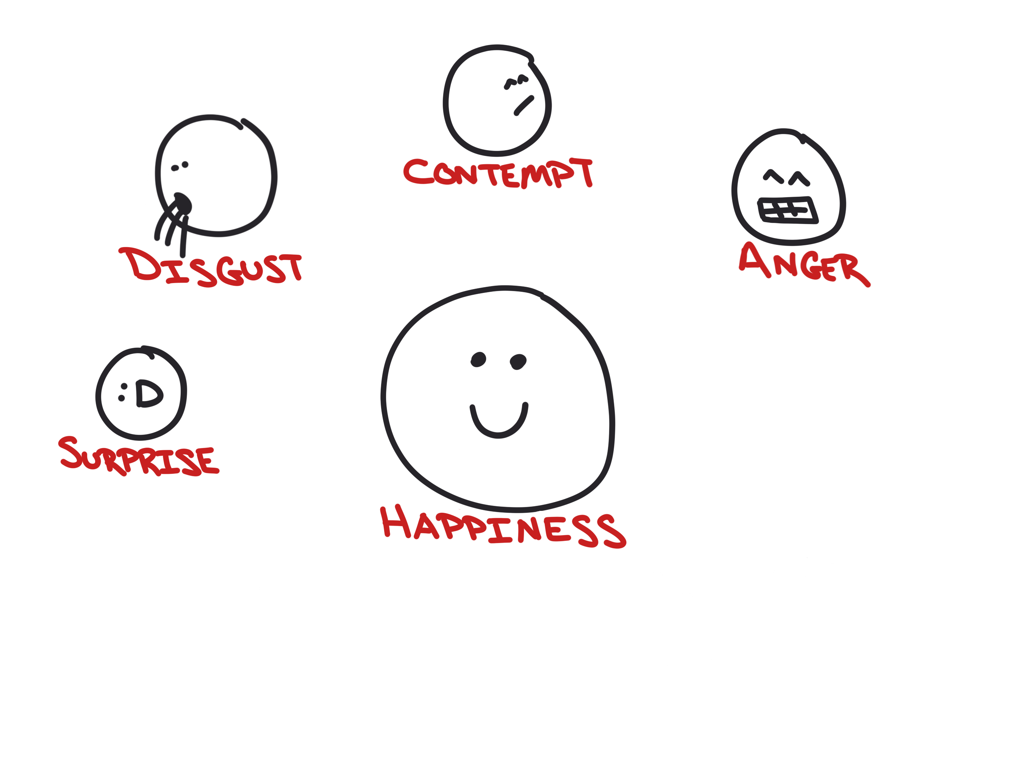
Score emotions in photos

Slide 43
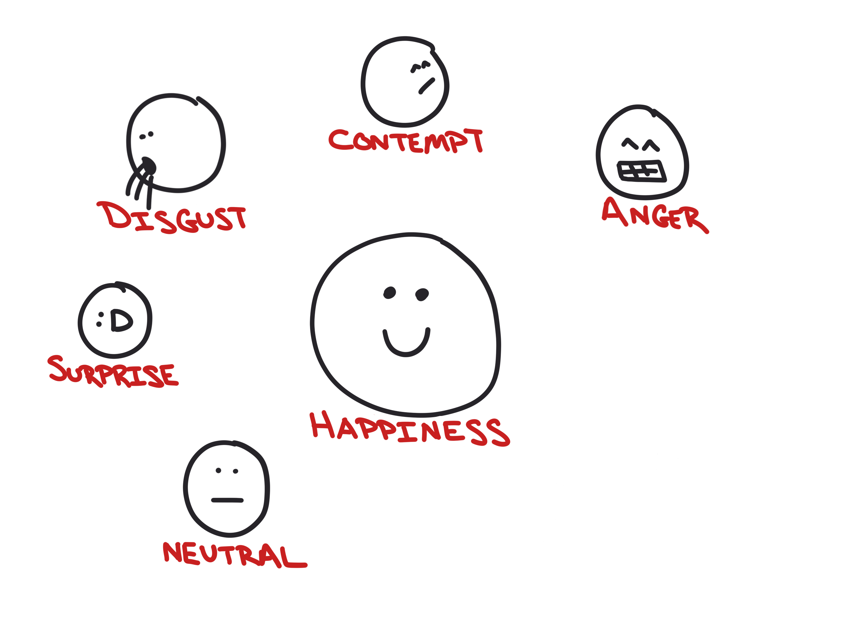
Score emotions in photos

Slide 44
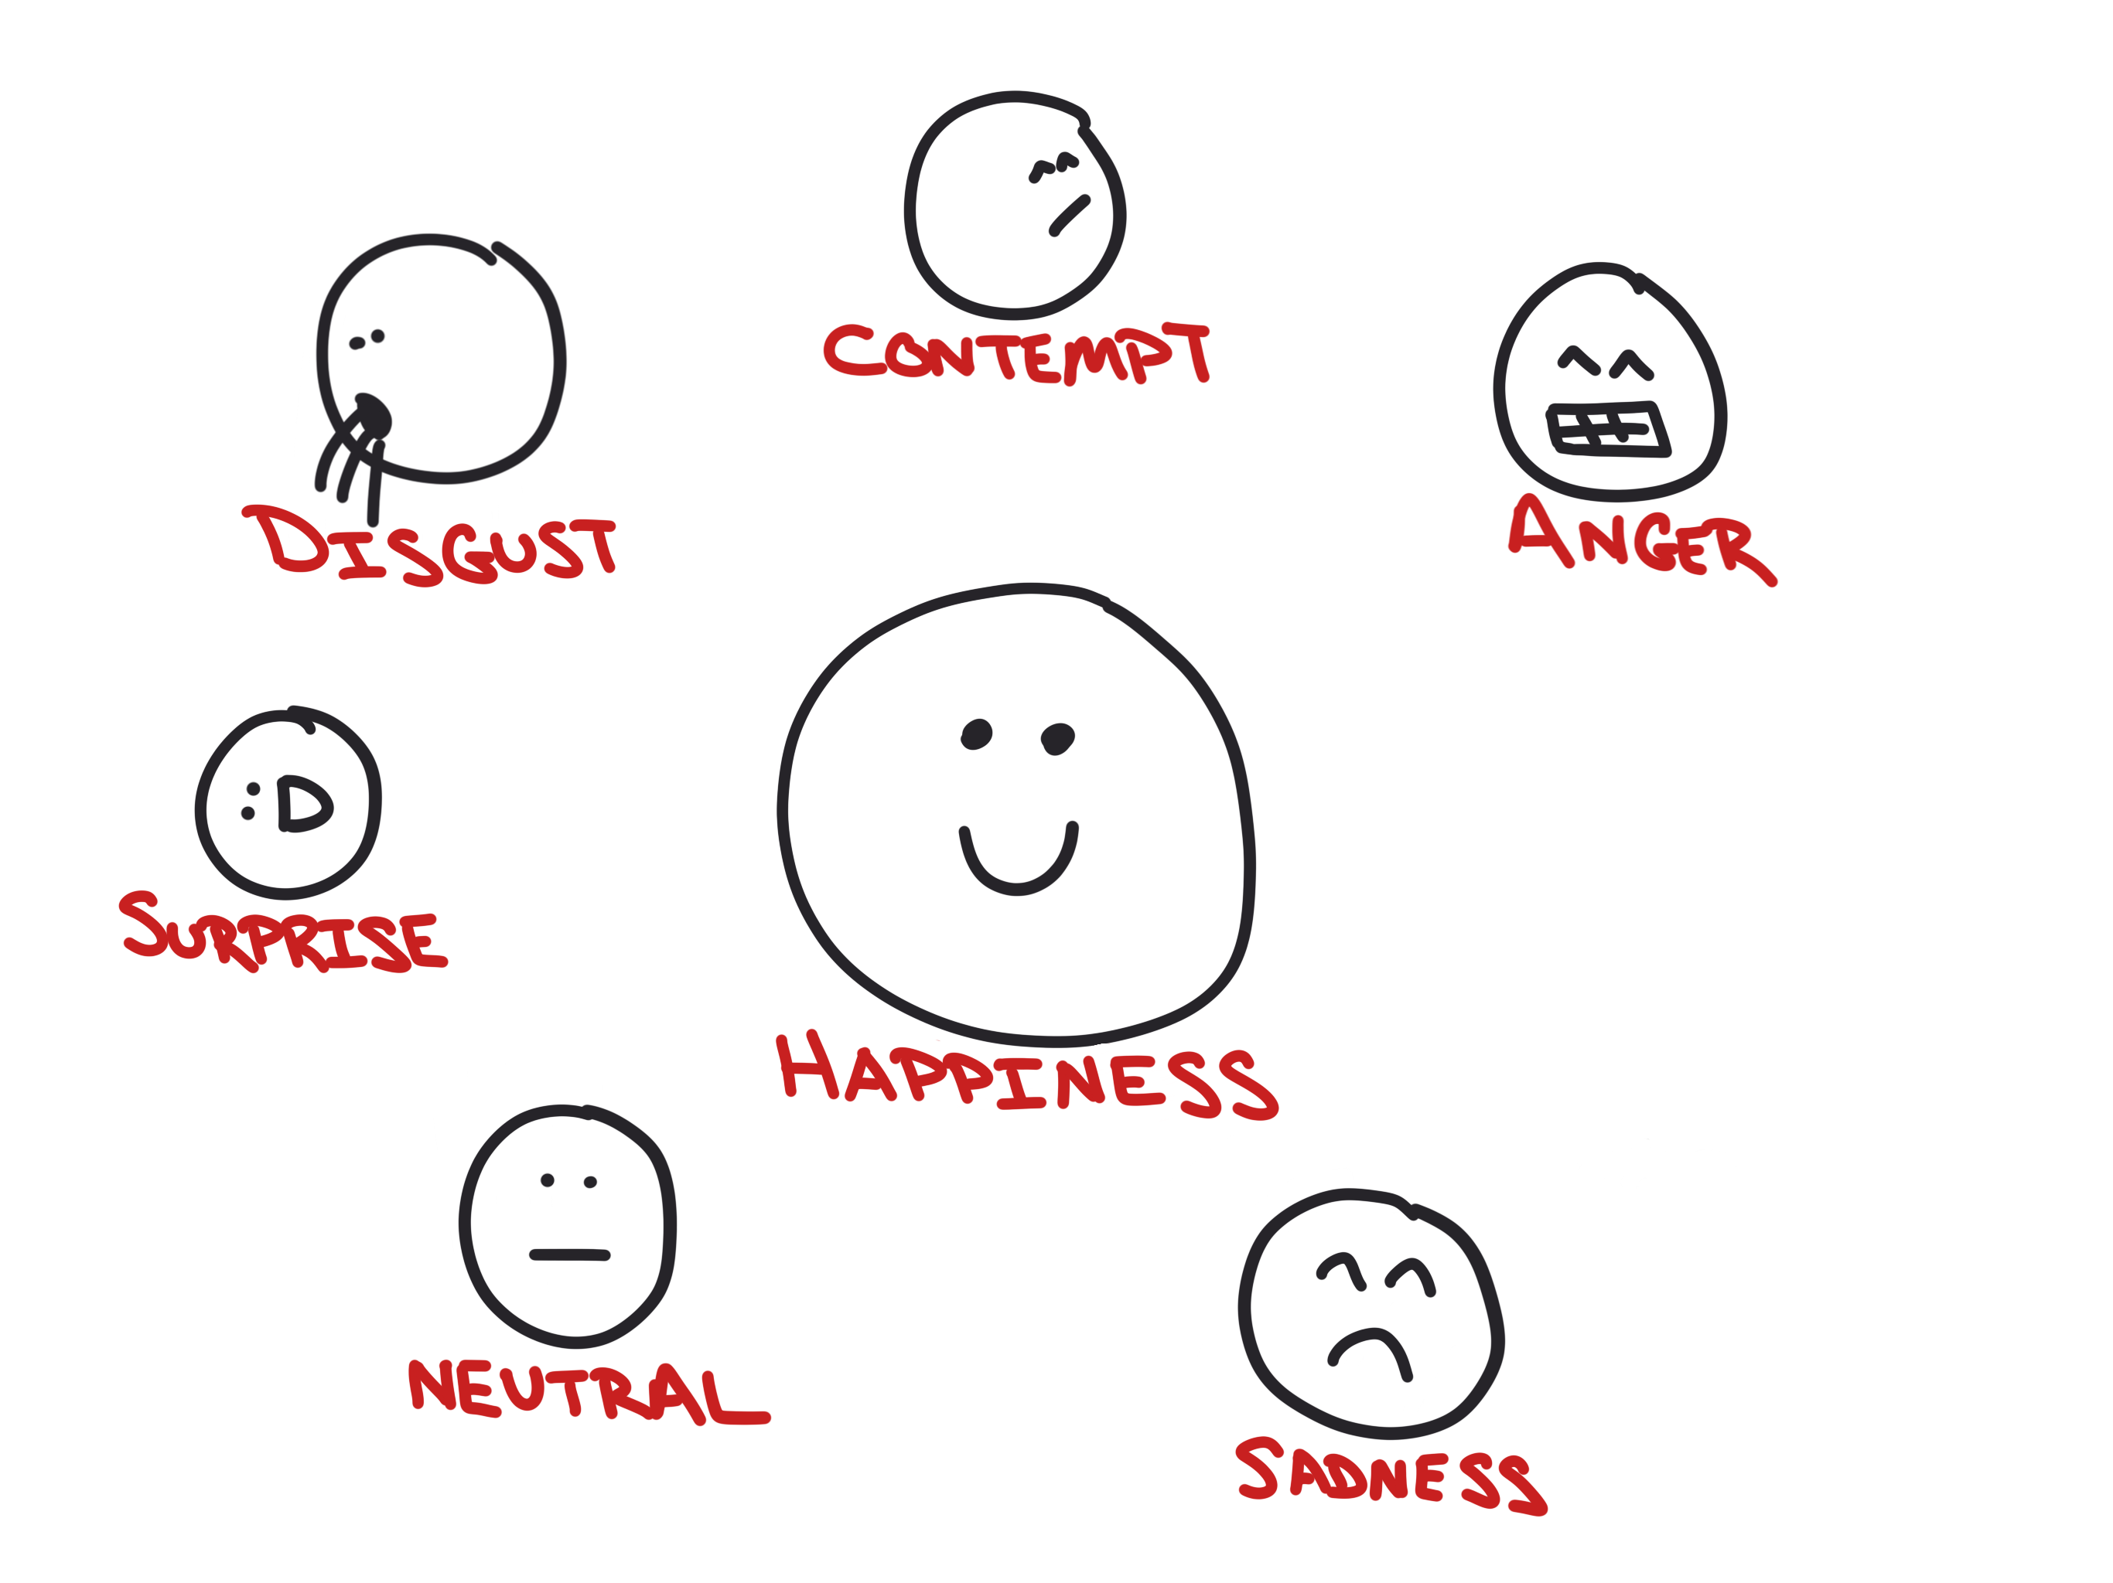
Score emotions in photos

Slide 45
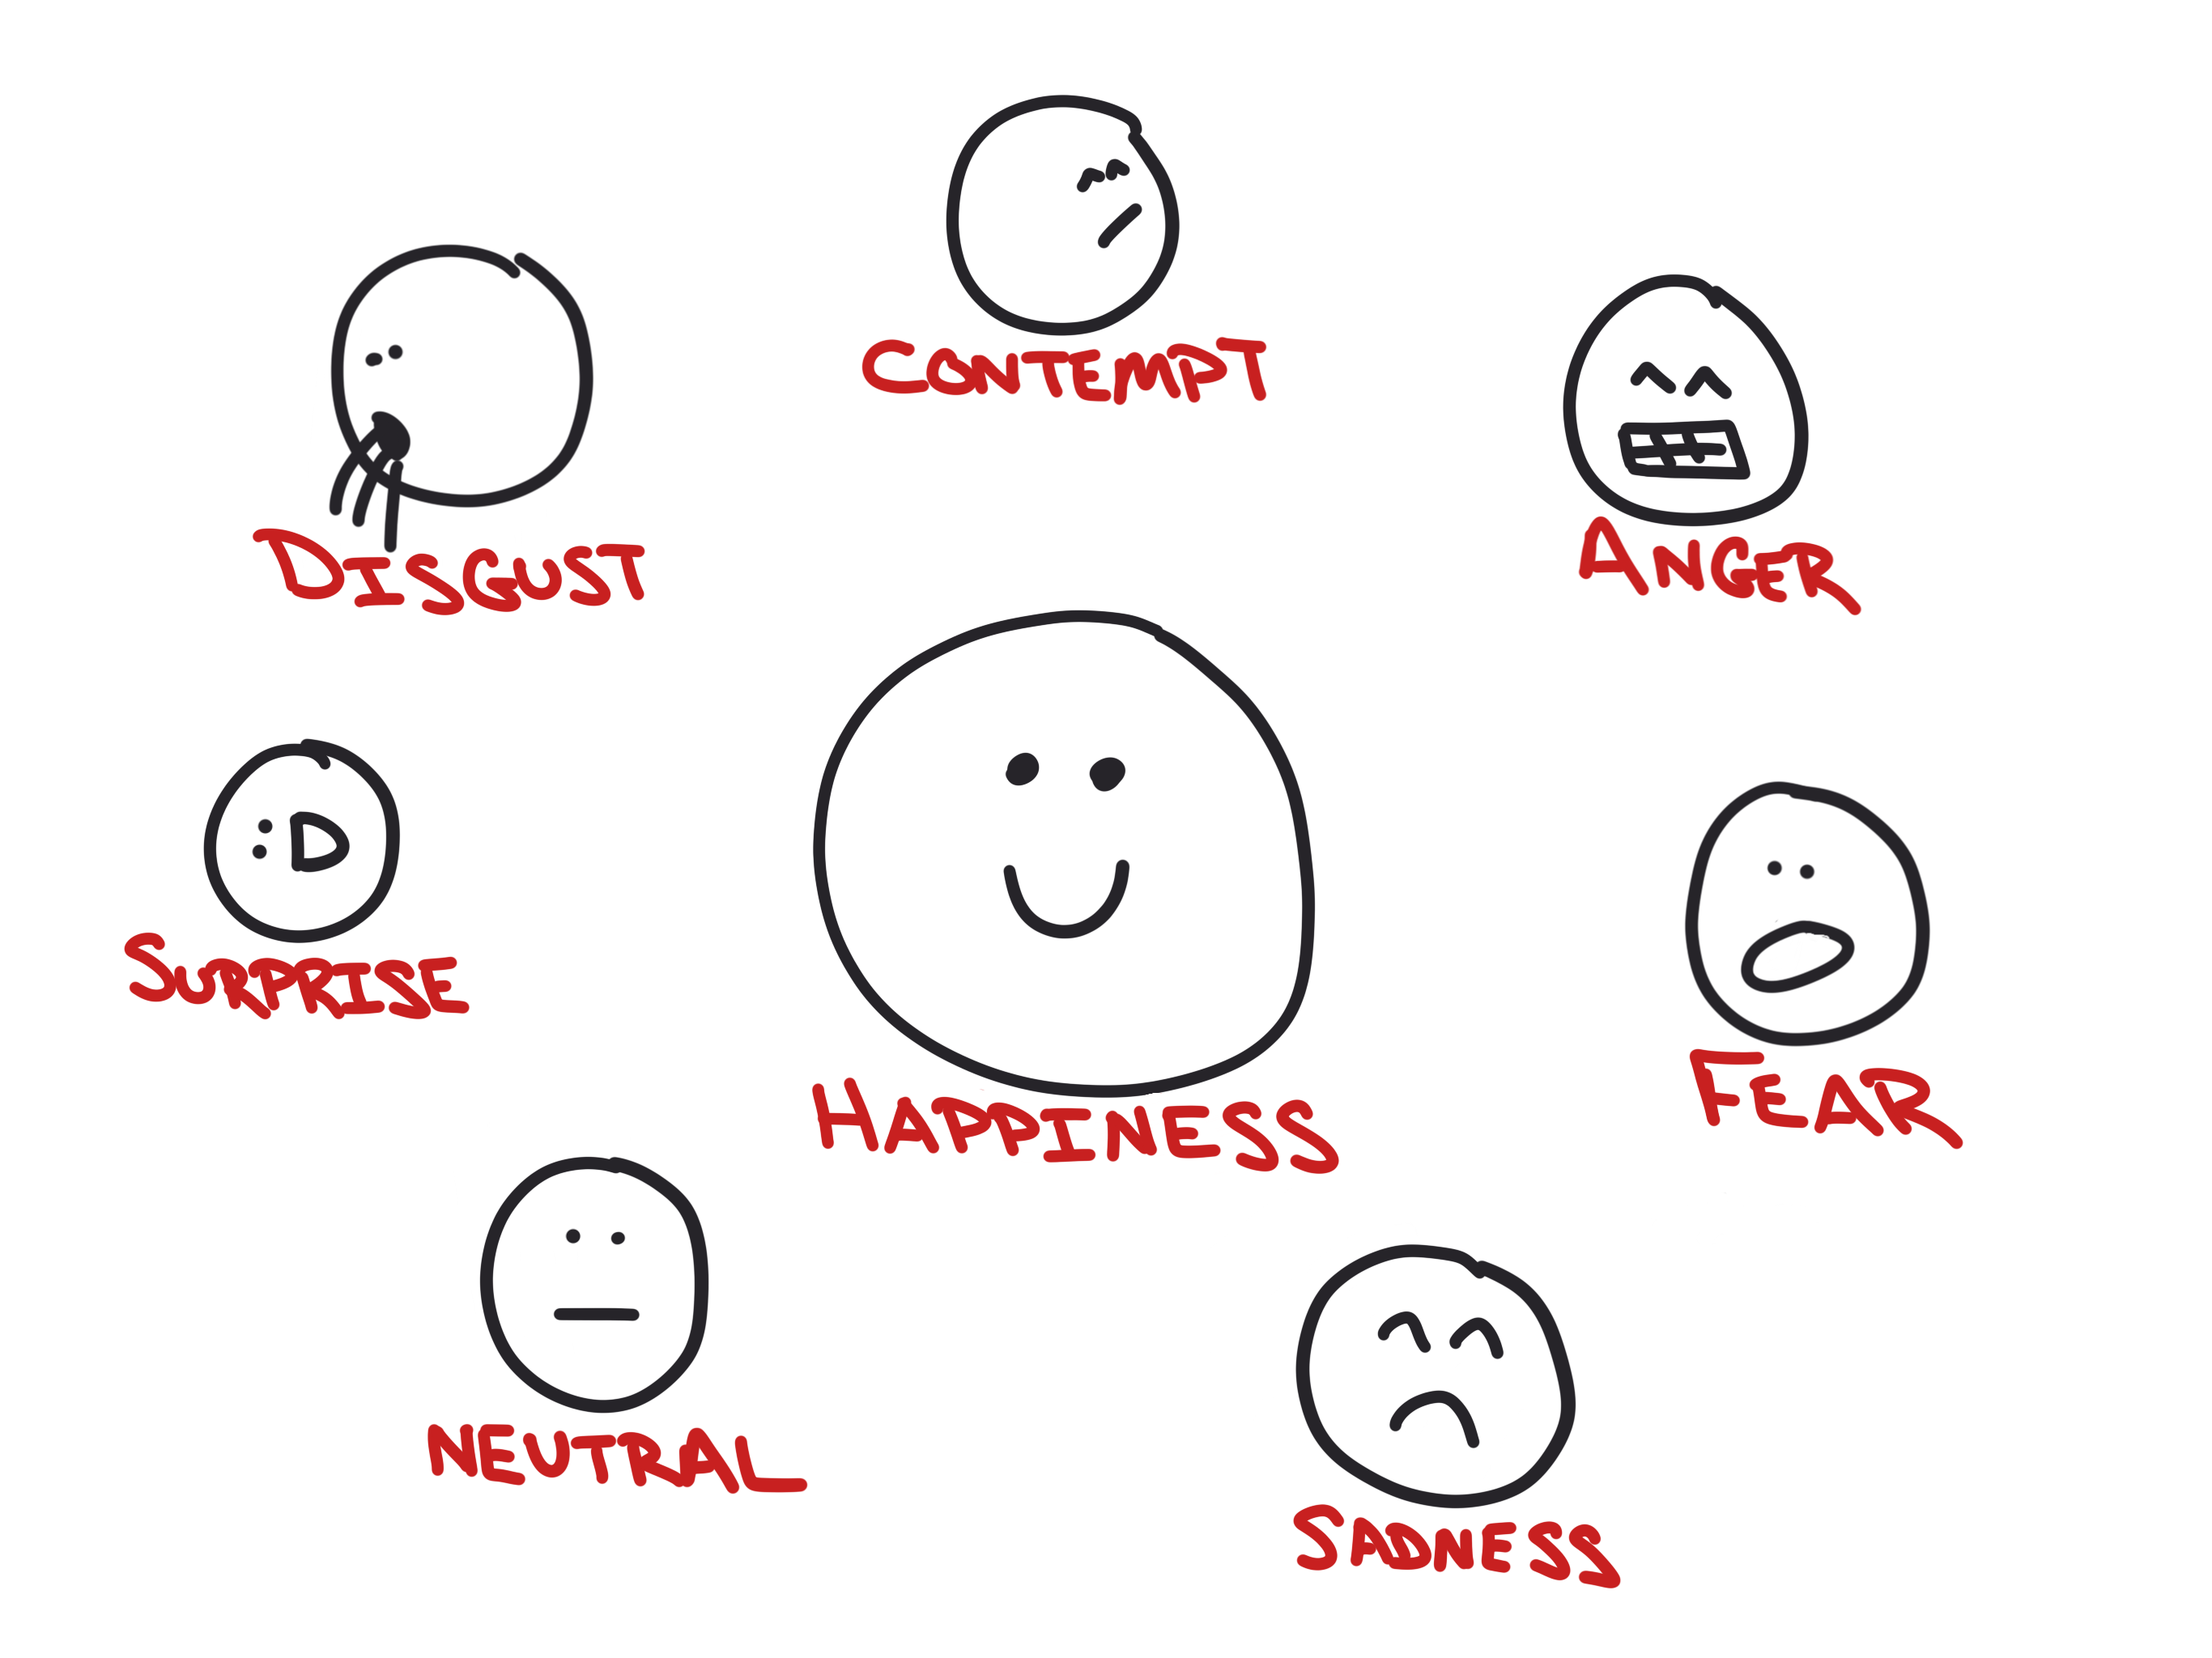
Score emotions in photos

Slide 47
The Vacation Itinerary…

Slide 48
Cognitive Services
Hosted in Azure
Machine learning
REST APIs

Slide 49
Lots of them…

Slide 50
Vision and OCR

Slide 51
Translation…

Slide 52
Emotions…

Slide 53


Slide 54
Making Apps More Human
AN INTRO TO MICROSOFT’S COGNITIVE SERVICES
Matthew Soucoup
PRINCIPAL
@codemillmatt codemilltech.com
Headshot optional

